Slide 1
Lecture 19 - Complement
Objectives
Understand what a Makefile is
Understand and familiarize with the structure of a Makefile
Write Makefile
Add commands to a Makefile
Compile using a Makefile
Dependency Graphs

Slide 2
What is a Makefile
It is not a text file
It is a file with text on it (WHICH IS DIFFERENT)
The objective of a Makefile is to automatically determine the “pieces” that need to be recompiled, while following a set of rules in order to achieve the big FINAL OBJECTIVE → COMPILE A PROGRAM
This utility will compile all the source codes. If one of them suffers a modification, only the one that was modified along with all those that depend on it will be recompiled.

Slide 3
Important about a Makefile
Name: Makefile (AS SHOWN – RESPECT IT)
This one will work → makefile (non capital M). However most programmers respect the capital M, and we will enforce that rule.
Any other name WON’T work

Slide 4
Makefile (Content)
Four (4) basic type of declarations
Comments
Variables
Explicit Rules
Implicit Rules

Slide 5
Makefile (Content)
Comments (#)
# this is a comment
# hello world
# today we do not have a quiz
# however we want a quiz
# We love quizzes

Slide 6
Makefile (Content)
Variables
Format: varName = data
Important: do not forget that we are using an “=“ (equal symbol, we will get back to it)
Example: SRC = main.c (Setting)
(Setting the content of SRC to “main.c”)
Example: $(SRC) (Accessing)
(Accessing/Extracting the content of the SRC variable)

Slide 7
Makefile (Content)
Variables
This means that a line such like this:
g++ $(SRC)
Will be interpreted as:
g++ main.c

Slide 8
Makefile (Content)
Variables (a.k.a MACROS)
It is possible for this variables to contain more than one “data” ? ANSWER: YES ☺ !!!
Example:
objects = program1.o program2.o program 3.o
program: $(objects)
gcc –o program $(objects)
program: is a TARGET (notice that “:” is used, NOT “=“)
The line below program MUST HAVE a TAB
The text after the TAB is a command

Slide 9
Makefile (Content)
MAKE IS CASE SENSITIVE
Which means that House and house are different.

Slide 10
Makefile (Content)
Explicit Rules
Format:
destinationFile: sourceFile(s)
TAB commands
------------------
Example:
main: main.c myFunctions.h
gcc –o main main.c myFunctions.h
Meaning:
In order for you to create the destinationFile (main), the existence of (main.c myFunctions.h) is required. We can say then, that (main.c and myFunctions.h) constitute a “dependency list”

Slide 11
Makefile (Content)
Explicit Rules (Continues)
Format:
destinationFile: sourceFile(s)
TAB commands
------------------
Example:
main: main.c myFunctions.h
gcc –o main main.c myFunctions.h
Meaning: In order for you to create the destinationFile (main)
The existence of (main.c myFunctions.h) is required. We can say then, that (main.c and myFunctions.h) constitute a “dependency list”
The execution of this command is needed
gcc –o main main.c myFunctions.h

Slide 12
Makefile (Content)
4. Implicit Rules
Similar to explicit rules BUT not the same
DO NOT mention the commands to be executed
INSTEAD →
Make will use of the “suffixes” (a.k.a file extensions) in order to determine the commands to be executed.
Example:
myFunctions.o: myFunctions.c myFunctions.h
Will generate →
$(CC) $(CFLAGS) -c myFunctions.c myFunctions.h

Slide 13
Makefile (Content)
4. Implicit Rules
Similar to explicit rules BUT not the same
DO NOT mention the commands to be executed
INSTEAD
Make will use of the “suffixes” (a.k.a file extensions) in order to determine the commands to be executed.
Example:
myFunctions.o: myFunctions.c myFunctions.h
Will generate →
$(CC) $(CFLAGS) -c myFunctions.c myFunctions.h
WHAT ??? $(CC) $(CFLAGS) (next page)

Slide 14
Makefile (Content)
4. Implicit Rules
Example:
myFunctions.o: myFunctions.c myFunctions.h
Will generate →
$(CC) $(CFLAGS) -c myFunctions.c myFunctions.h
WHAT ??? $(CC) $(CFLAGS)

Slide 15
Makefile (Content)
MORE ABOUT MACROS (VARIABLES)
There is a group of variables (MACROS) that can be used with “both types of rules”. This group is divided in two different categories.
Program names → i.e = CC = your C compiler here
Arguments for your programs→ i.e = CFLAGS
Example:
CC = WHAT SHOULD WE HAVE HERE ?
CFLAGS = -Wall –O2
(of course, its content will depend on your needs)

Slide 16
Makefile (Content)
MORE ABOUT MACROS (VARIABLES)
In addition to those “user defined macros”. The user can make use of a number of “Built-in” Macros.
Here a list of the most common ones.
$< → It will copy the 1st name in your dependency list
$@ → It will copy the current target name
$^ → it will copy ALL the file names in the dependency list
$* → FOR STUDENTS TO RESEARCH
$? → FOR STUDENTS TO RESEARCH

Slide 17
Makefile (Content)
MORE ABOUT MACROS (VARIABLES)
Given:
CC=WHAT SHOULD GO HERE ??
CFLAGS = - Wall
project: yourCppFile.c
$(CC) $(CFLAGS) project yourCppFile.c
--------------------------------------------
Transformation 1: (assuming additional files for dependency)
CC = something here
project: yourCppFile.c header1.h
$(CC) –o $@ $^

Slide 18
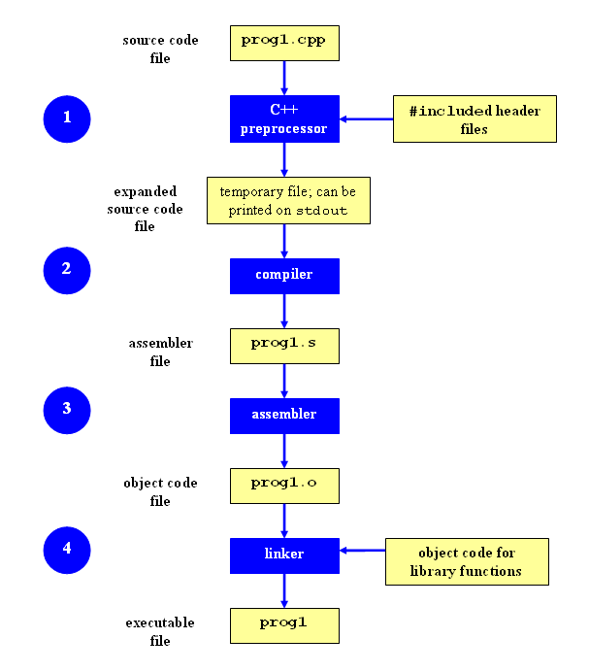
C++ Compilation Process
http://faculty.cs.niu.edu/~mcmahon/CS241/Notes/compile.html

Slide 19
Compilation Process C++
Compiler
Fa.c
Assembler
*.s
Fa.o
Linker
header.h
a.out
Executable File
*.s
Fb.o
Fb.c
Use it for Dependency graph

